Slide 1

ACT 1294 of 2013
A.C.A. § 6-41-601, Title 6, Subtitle 3, et al.
Meeting the Needs of Children with Dyslexia in Public Schools
Vicki King, M.Ed., CALT, QI
Arkansas Department of Education
Dyslexia Specialist
vicki.king@arkansas.gov
(501)682-3213

Slide 2
Dyslexia Resources
Arkansas Department of Education (ADE)
Dyslexia Page
Go to: http://www.arkansased.org
Click on the “D”
Select “Dyslexia”
Review Related Files

Slide 3
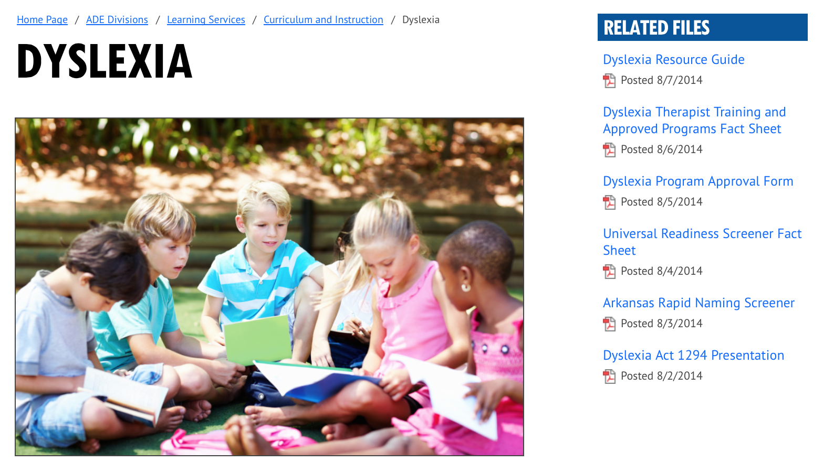
Related Files

Slide 4
The Arkansas State Legislature
enacted Act 1294 of 2013, codified as A.C.A. § 6-41-601, Title 6, Subtitle 3, et al., to ensure that children with dyslexia
have their needs met by the public school system.

Slide 5
Components of the Law
A.C.A. § 6-41-601 Findings
A.C.A. § 6-41-602 Definitions
A.C.A. § 6-41-603 Required screening and intervention
A.C.A. § 6-41-604 Additional dyslexia evaluation and services
A.C.A. § 6-41-605 Instructional approaches
A.C.A. § 6-41-606 Reporting by school districts
A.C.A. § 6-41-607 Dyslexia Specialist
A.C.A. § 6-41-608 Dyslexia Professional Awareness
A.C.A. § 6-41-609 Dyslexia and related disorder education in teacher education programs
A.C.A. § 6-41-610 Dyslexia Resource Guide

Slide 6
A.C.A. § 6-41-601 Findings
Delayed identification is detrimental to a child’s academic success and self-esteem.
Dyslexia can be successfully treated.
Early identification and intervention is significantly less than the cost of intensive remediation.

Slide 7
A.C.A. § 6-41-602 Definitions
Dyslexia is a specific learning disability that is neurological in origin. It is characterized by difficulties with accurate and/or fluent word recognition and by poor spelling and decoding abilities. These difficulties typically result from a deficit in the phonological component of language that is often unexpected in relation to other cognitive abilities .

Slide 8
IDA’s Research Based Definition
Dyslexia is a specific learning disability that is neurological in origin. It is characterized by difficulties with accurate and/or fluent word recognition and by poor spelling and decoding abilities. These difficulties typically result from a deficit in the phonological component of language that is often unexpected in relation to other cognitive abilities and the provision of effective classroom instruction. Secondary consequences may include problems in reading comprehension and reduced reading experience that can impede the growth of vocabulary and background knowledge.
Adopted by the Board of Directors, International Dyslexia Association: November 2002

Slide 9
A.C.A. § 6-41-602 Definitions
“Dyslexia therapist” means a professional who has completed training and obtained certification in dyslexia therapy from a dyslexia therapy training program approved by the Arkansas Department of Education.

Slide 10
A.C.A. § 6-41-602 Definitions
“Dyslexia therapy” means an appropriate specialized instructional program that is:
Delivered by a dyslexia therapist
Systematic, multisensory and research-based
Offered in a small group setting

Slide 11
A.C.A. § 6-41-603 Required Screening and Intervention
Level 1: Universal Screener
Who is screened?
ALL K-2 students
          -This includes transfers from other districts and states
Any student in grades 3 -12 experiencing difficulty as noted by a classroom teacher

Slide 12
A.C.A. § 6-41-603 Required Screening and Intervention
Are there exemptions to the screening?
Students with an existing diagnosis of dyslexia.
Students with a sensory impairment.

Slide 13
A.C.A. § 6-41-603 Required Screening and Intervention
What is the designated screening tool?
The Arkansas Department of Education shall adopt rules to ensure that students will be screened using DIBELS.

Slide 14
A.C.A. § 6-41-603 Required Screening and Intervention
What areas are to be assessed?
The screening should include:
Phonological and phonemic awareness;
Sound symbol recognition;
Alphabet knowledge;
Decoding skills;
Rapid naming skills; and
Encoding.

Slide 15
What is used to measure rapid naming?
Arkansas Rapid Automatized Naming (AR-RAN)
Where can the AR-RAN be found?
http://www.arkansased.org/public/userfiles/Learning_Services/Dyslexia/Arkansas_Rapid_Naming_Screener.pdf

Slide 16
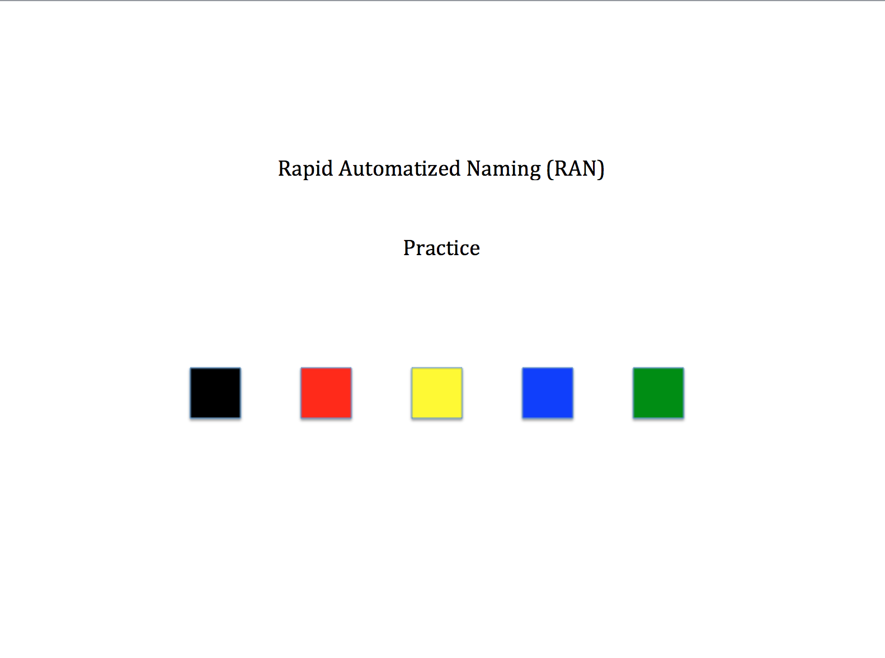
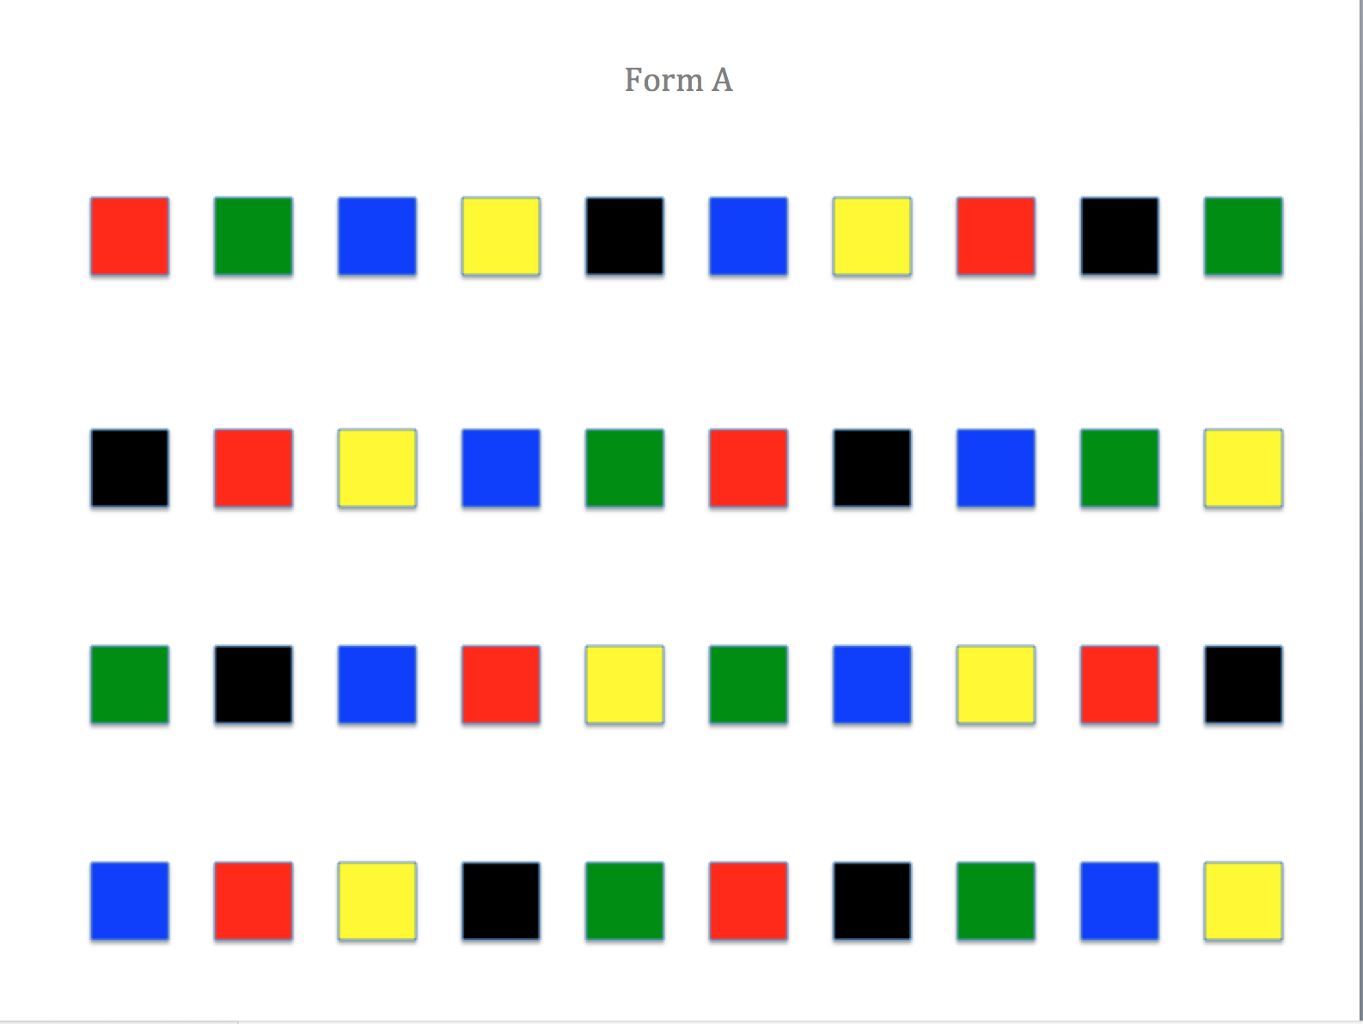
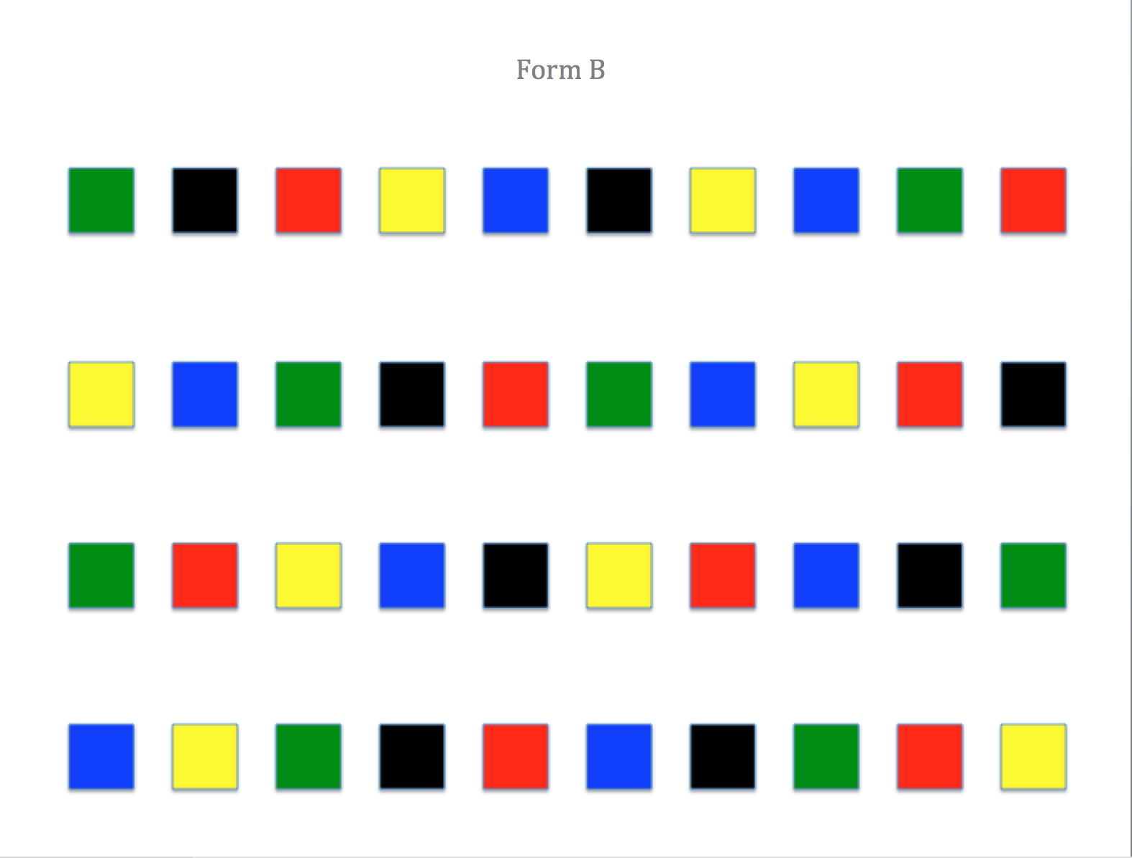
AR-RAN
Record the time it takes a child to read all four rows.
Combine the two times and rank by grade level to set district or campus norms.

Slide 17
What is used to measure encoding (spelling)?
Suggested Assessment:
Developmental Spelling Analysis (DSA)
Words Journeys by Kathy Ganske
Kindergarten Inventory of Developmental Spelling (KIDS)
Word Journey 2nd Ed.
Determine stage and feature scores.

Slide 18
Assessing the Six Required Areas in Grades K & 1
 | Phonological/Phonemic Awareness (Blending/Segmenting) | Sound-symbol recognition (Phonics) | Alphabet knowledge (Alphabetic Principle) | Decoding (Blending- Phonics) | Rapid Naming | Encoding (Segmenting-Phonics)
PSF | X
LNF |  |  | X
NWF | X | X | X | X
DSA | X | X | X |  |  | X
AR-RAN |  |  |  |  | X
Notes:
First 100 high frequency words.

Slide 19
Assessing the Six Required Areas in Grade 2
 | Phonological/Phonemic Awareness (Blending/Segmenting) | Sound-symbol recognition (Phonics) | Alphabet knowledge (Alphabetic Principle) | Decoding (Blending- Phonics) | Rapid Naming | Encoding (Segmenting-Phonics)
*PSF | X
*LNF |  |  | X
NWF | X | X | X | X
ORF | X | X | X | X
DSA | X | X | X |  |  | X
AR-RAN |  |  |  |  | X
Notes:
First 100 high frequency words.

Slide 20
Assessing the Six Required Areas in Grades 3-6
 | Phonological/Phonemic Awareness (Blending/Segmenting) | Sound-symbol recognition (Phonics) | Alphabet knowledge (Alphabetic Principle) | Decoding (Blending- Phonics) | Rapid Naming | Encoding (Segmenting-Phonics)
ORF | X | X | X | X
DSA | X | X | X |  |  | X
RAN |  |  |  |  | X
Notes:
First 100 high frequency words.

Slide 21
Assessing the Six Required Areas in Grades 7-12
 | Phonological/Phonemic Awareness (Blending/Segmenting) | Sound-symbol recognition (Phonics) | Alphabet knowledge (Alphabetic Principle) | Decoding (Blending- Phonics) | Rapid Naming | Encoding (Segmenting-Phonics)
ORF | X | X | X | X
DSA | X | X | X |  |  | X
RAN |  |  |  |  | X
Notes:
First 100 high frequency words.

Slide 22
If DIBELS Screening indicates the need for intervention, the Response to Intervention (RTI) shall be used to address the needs of the student.
If RTI indicates the possibility of dyslexia, the student shall be evaluated.
A.C.A. § 6-41-603 Required Screening and Intervention

Slide 23
Tiers of Instruction
TIER 1
General Education (Core) Classroom Instruction
_________________
All Students
TIER 2
Strategic Instruction
(Intervention)
20- 30%
__________________
TIER 3
Comprehensive Assessment
__________________
Intensive Instruction
5-10 % _________________
With effective TIER 1 instruction
10 – 15%
Universal Screening /
Benchmark Assessments
Phonological awareness
Sound symbol recognition
Alphabet knowledge
Decoding skills
Rapid naming skills
Encoding skills
ID
Progress Monitoring
With effective TIER 2 instruction
5%
ID
Timothy N. Odegard PhD, CALP
Notes:
Speaker Notes:
Example of Fundations implementation in a Multi-Tier scenario – Tier 1 and Tier 2
Tier 1 Instruction: Fundations standard lesson occurs within the general education classroom and taught to all students.
Students identified as at-risk and in need of additional support (usually lowest 30th%) move into Tier 2.
Tier 2 Instruction: Students receive Double Dose Fundations lesson which involves targeted Fundations activities in small groups up to 30 minutes 3-5 times a week.
So, those students in Tier 2 are receiving the Fundations daily lesson plan with the whole class, AND additional Fundations instruction in small groups.
If students in Tier 2 do not respond to the double dose intervention, a more complete diagnostic assessment would be conducted to determine what instruction is required.

Slide 24
Level 2: Dyslexia Evaluation
A.C.A. § 6-41-604 Additional Dyslexia Evaluation and Services
Completed by a trained professional using norm-referenced testing;
Used to determine if markers of dyslexia are present;
Used to determine if therapeutic services are warranted;
Used to determine a student’s eligibility for services and accommodations under Section 504.

Slide 25
Who are we going to evaluate?
Students demonstrating :
unexpected difficulties in reading despite effective (evidence-based) reading instruction.
characteristics of dyslexia.

Slide 26
When are we going to evaluate?
When RTI and progress monitoring indicates the student is not making sufficient progress to close the gap between performance and achievement
When characteristics of dyslexia are suspected

Slide 27
What are we going to assess?
Phonological Awareness
Rapid Naming
Alphabet Knowledge
Underlying Cause:
Decoding (Nonsense Words)
Word Recognition (Real Words)
Fluency (Rate and Accuracy)
Spelling
Characteristics:
Outcomes:
Reading Comprehension

Slide 28
A.C.A. § 6-41-604 Additional Dyslexia Evaluation and Services
When Students Exhibit Markers of Dyslexia on Level 2: Dyslexia Evaluation
Parents or legal guardians are notified of results of the Dyslexia Evaluation
Parents or legal guardians are provided information and resource materials
    Common indicators of dyslexia
    Appropriate classroom interventions and accommodations
    The right of the parent or legal guardian to have receive an independent evaluation
Student receives dyslexia therapy services
Student progress is continually monitored
Schools may perform a Level III: Comprehensive Dyslexia Evaluation

Slide 29
Independent Evaluation
A.C.A. § 6-41-604
At any time, a parent may seek an independent, dyslexia evaluation.
  Licensed psychological examiner
  School psychology specialist
  Licensed speech-language pathologist
  Certified dyslexia training specialist
The school district shall consider a diagnosis from independent evaluation and allow students to receive direct intervention from a dyslexia therapist.

Slide 30
Level 3: Comprehensive Dyslexia Evaluation
Purpose: Diagnosis, Intervention Planning, and Documentation
Who can diagnose: Professionals with advanced degrees in administration and interpretation of diagnostic assessments. (Licensed Psychologist, Licensed Psychological Examiner, School Psychology Specialist, Speech Language Pathologist…)

Slide 31
Level 3: Comprehensive Dyslexia Evaluation
What should be assessed: Diagnosis involves data gathering and observation of areas such as expressive and receptive language skills, intellectual functioning, cognitive processing and educational achievement. A comprehensive dyslexia evaluation is used to determine if the student’s learning problems are specific to reading or whether they are related to other disorders like ADHD, anxiety, depression, Central Auditory Processing Disorder, or other physical or sensory impairments.
http://ncld.org/parents-child-disabilities/ld-testing/testing-for-dyslexia http://www.interdys.org/ewebeditpro5/upload/TestingandEvaluation.pdf

Slide 32
A.C.A. § 6-41-602 Definitions
“Dyslexia therapist” means a professional who has completed training and obtained certification in dyslexia therapy from a dyslexia therapy training program approved by the Arkansas Department of Education.
“Dyslexia therapy” means an appropriate specialized instructional program that is:
  Delivered by a dyslexia therapist
  Systematic, multisensory and research-based
  Offered in a small group setting

Slide 33
A.C.A. § 6-41-605 Instructional Approaches
Content:
Phonology / phonological awareness
Sound-symbol association
Syllable instruction
Morphology
Syntax
Semantics
Strategies for decoding, encoding, word recognition, fluency, and comprehension
Principles of Instruction:
Explicit, direct instruction
Systematic, sequential, and cumulative
Individualized
Comprehensive and inclusive (meaning based)
Multisensory

Slide 34
ADE Approved Programs
Until there are a sufficient number of graduates from a dyslexia therapy program established at the university level in Arkansas or from dyslexia therapy program established at the university level in another state that is approved by the ADE, the department shall allow dyslexia therapy to be provided by individuals who have received training and certification from a program approved by the department (A.C.A. § 6-41-605).

Slide 35
ADE-Approved (Certification)
Dyslexia Therapy Training Programs are:
Therapist level training courses;
Accredited by International Dyslexia Association (IDA) or International Multisensory Language Education Council (IMSLEC); with a
National certification exam.

Slide 36
Dyslexia Therapist Training
Participant Requirements
Degree: Bachelors in Education or related field
Course work: Minimum of 200 clock hours
Practicum: 700 clock hours teaching beginning and upper levels of instruction
3 different cases
10 demonstration lessons
24 month minimum
Written reports documenting therapy situations and progress
Supervision: Direct observation by a Qualified Instructor

Slide 37
University Program of Study (Endorsement)
Possible 12-15 graduate hours
Internship
ADE is facilitating the writing of the competencies
Blended into existing degree programs
  Reading Specialists
  Special Education
  Speech Pathology, etc.

Slide 38
Dyslexia Therapist
A.C.A. § 6-41-602
A professional who has completed training and obtained certification in dyslexia therapy from a dyslexia therapy training program approved by the Arkansas Department of Education.
Timeline:By 2015-2016, school districts shall have individuals to serve as dyslexia interventionists as defined in the Dyslexia Resource Guide who are trained interventionists by the department or using other dyslexia training programs approved by the department (A.C.A. § 6-41-607).

Slide 39
ADE Approved Programs
If the school district determines the following five (5) criteria are met within a dyslexia program, that program is considered approved and may be used for dyslexia. No application is required.
Training course is delivered by a certified trainer in the selected dyslexia program
Training and program is systematic and researched based
Instruction is multisensory
Provides small group instruction in the essential components of reading including phonemic awareness, graphophonemic knowledge, and structure of the English language, linguistic instruction and strategies for decoding, encoding word recognition, fluency and comprehension.
The program is approved by another state department of education as an approved dyslexia program.

Slide 40
*If the program meets criteria 1-4 but is not recognized as an approved program by another state department of education, the district must submit the Dyslexia Program Approval Form.
Training course is delivered by a certified trainer in the selected dyslexia program
Training and program is systematic and researched based
Instruction is multisensory
Provides small group instruction in the essential components of reading including phonemic awareness, graphophonemic knowledge, and structure of the English language, linguistic instruction and strategies for decoding, encoding word recognition, fluency and comprehension.
Dyslexia Program Approval Form

Slide 41
Dyslexia Professional Awareness
A.C.A. § 6-41-608
No later than the 2014-2015 school year, the Department of Education shall ensure that each teacher receives professional awareness on
The indicators of dyslexia; and
The science behind teaching a student who is dyslexic.
The professional awareness may be provided:
Online;
At an education service cooperative; or
At another venue approved by the ADE
ArkansasIdeas online course:
Dyslexia: A Three Part Professional Development (1 hour credit)

Slide 42
Act 1294 Dyslexia Reality
The reality for schools:
Strong core reading programs
Response to Intervention
Early intervention for students
Therapy for K-12 students with markers of dyslexia

